Slide 1

BUSINESS ANALYSIS
Cilacademycohort4 week 3: Uchechukwu Ikebudu

Slide 2

OBJECTIVES
cilacademycohort4 week3:uchechukwu Ikebudu
WHAT IS BUSINESS ANALYSIS AND WHO IS A BA
TECHNIQUES AND TOOLS USED IN BUSINESS ANALYSIS
STEPS INVOLVED IN BUSINESS ANALYSIS AND THE SKILLS OF A BA
ROLES AND FUTURE OF A BA

Slide 3

What is Business Analysis
Business Analysis as defined by IIBA as the enabling of
change in an enterprise by defining needs and
recommending solutions that are of value
to business stakeholders.

Slide 4
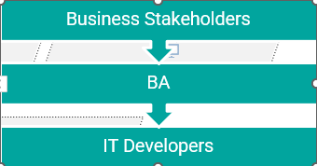
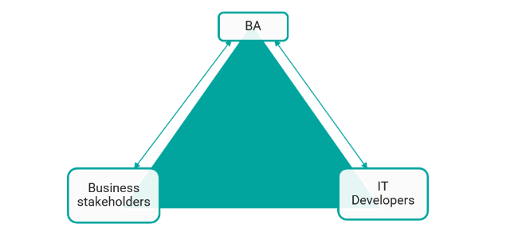
Who is a BA
A business analyst uses data analysis and insights to make profitable decisions and checks integration of technology with business model.

Slide 5
Steps involved in business Analysis
Cilacademycohort4: uchechukwu Ikebudu
Assessment
Implementation
Define detailed requirements
Business analysis plan
Define scope
Business Objectives
Info gathering

Slide 6
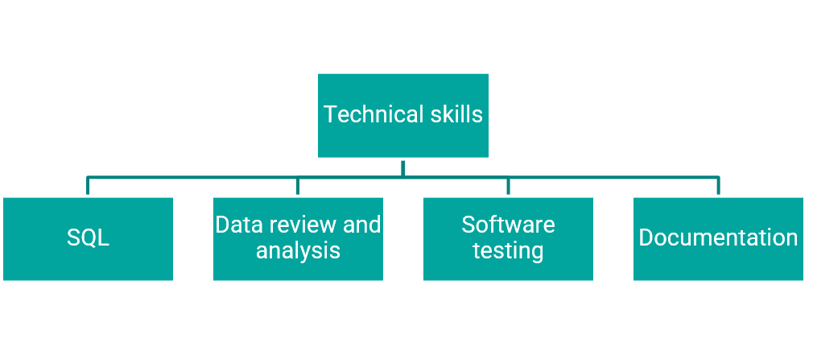
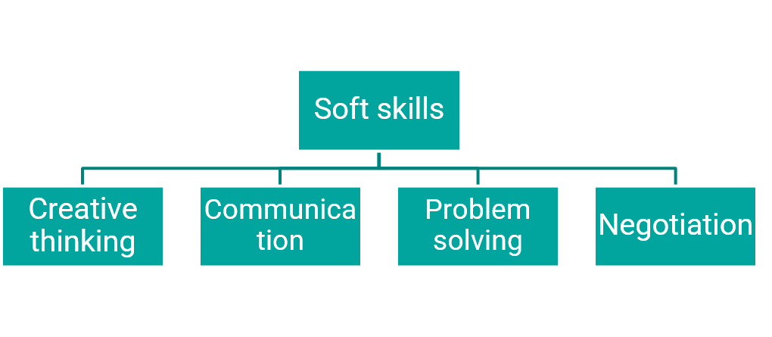
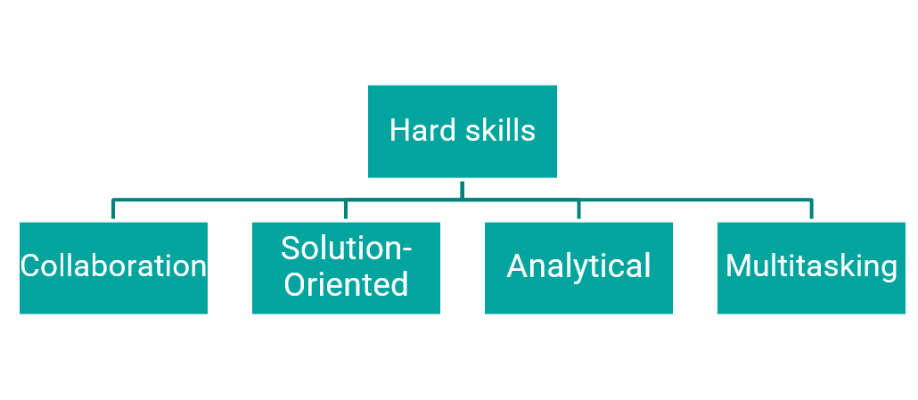
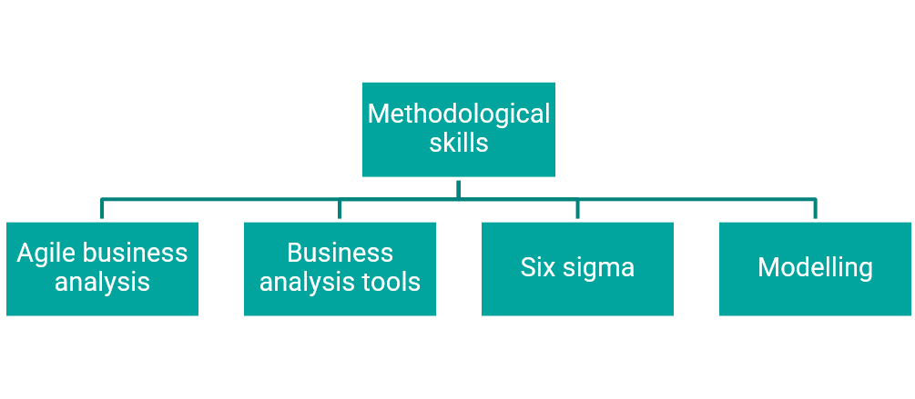
Skills of a BA

Slide 7
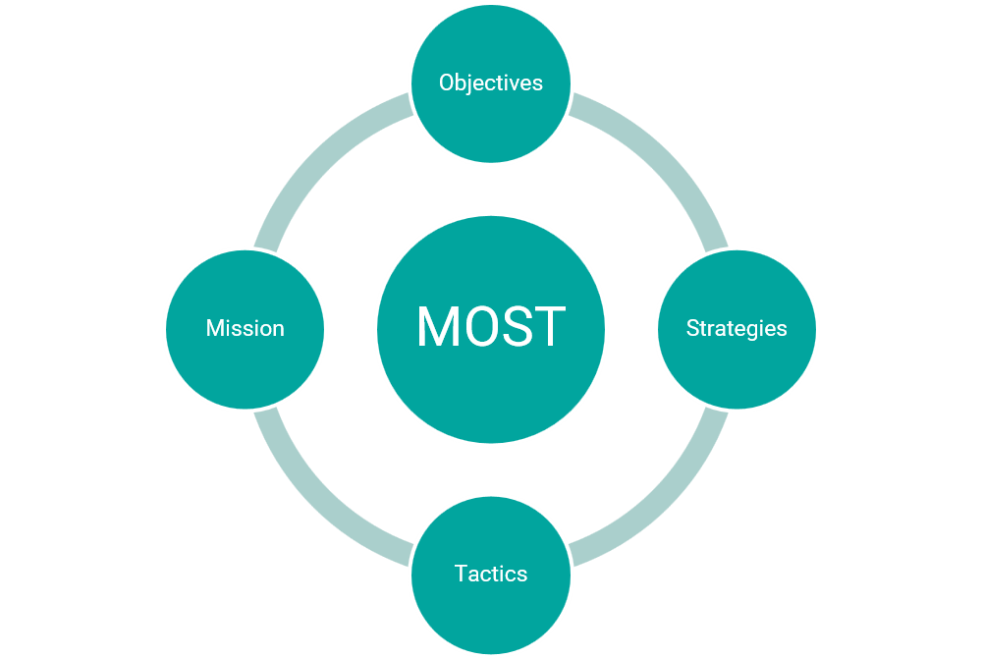
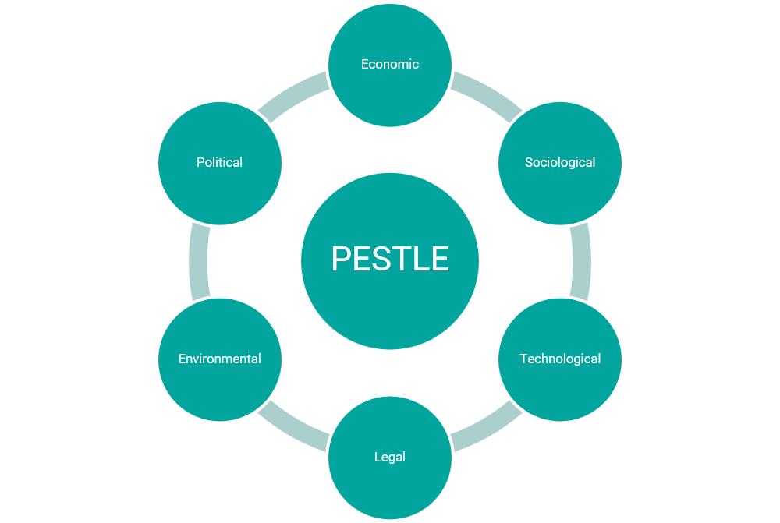
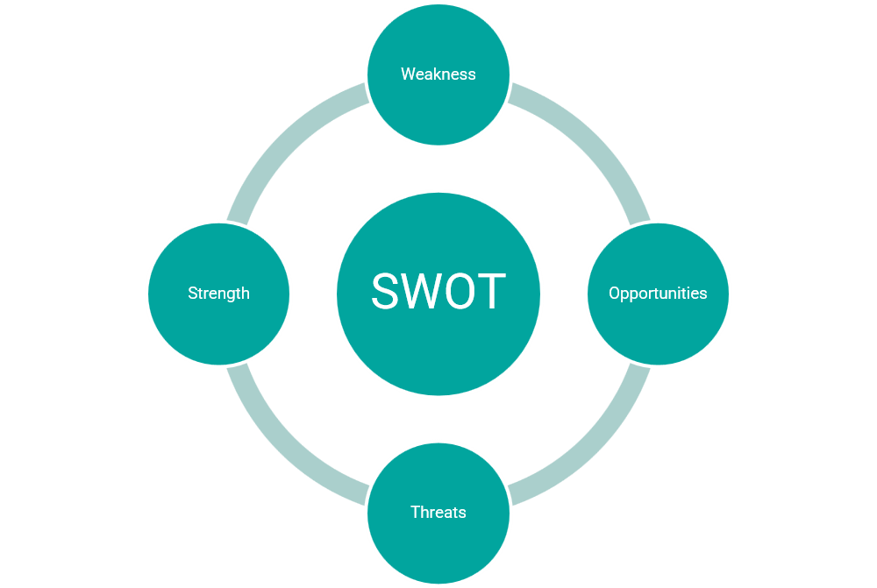
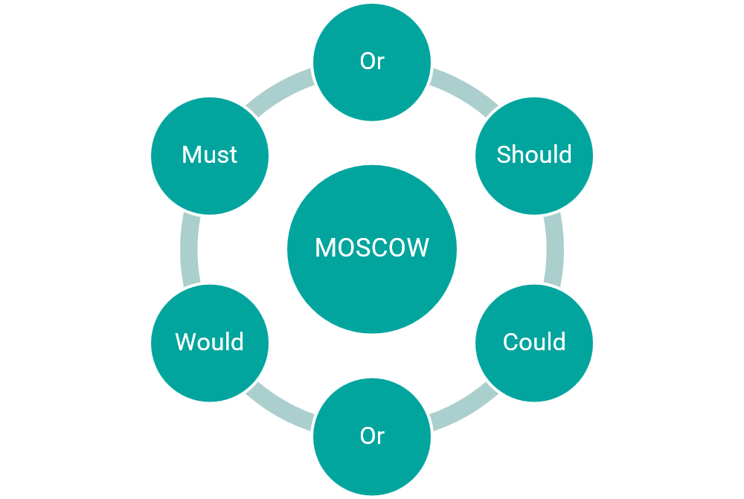
BA Techniques

Slide 8
BA TOOLS
Analysis tools: Visio
Microsoft Office tools: Powerpoint, Excel, word, visio
Pencil
Rational Requisite Pro
Google docs
Balsamiq: Project value, Trello, VersionOne lifecycle
Smartdraw

Slide 9
Future of a BA
BA
Senior Analyst
Project Manager
Product Owner

Slide 10
Roles of a BA
Multitasking
Reach the goals of the organization
Communicate with Stakeholders
Determine a suitable way to improve the business processes
Implement new features
Identifying ways to make analysis easier
Analyze and validate the need for a change in business plan

